Slide 1
React Hooks
Fullstack Team

Slide 2
Introduction of Hooks
React Hooks were introduced in React 16.8 as a way to use state and other React features without using class components.
Here are some advantages of using hooks over class components:​
Simplicity: Hooks simplify code and make it easier to understand.
Reusability: With hooks, we can extract reusable logic into custom hooks that can be shared across multiple components. This makes it easier to maintain and update the code.
Scalability: Hooks make it easier to handle complex state management and logic in large applications.
Better performance: Hooks can optimize component rendering and state management, which can improve the performance of the application.
Cleaner code: Hooks allow developers to separate concerns, leading to cleaner and more organized code.
Testing: Hooks are easier to test than class components, as they don't rely on lifecycle methods.

Slide 3
Rules for using Hooks:
Use Hooks Only in Function Components: React Hooks can only be used in function components and not in class components or outside of a component. This is because Hooks rely on the function component’s call order to work correctly.
Use Hooks at the Top Level: Hooks must be called at the top level of a function component or inside a custom hook. They should not be called in loops, conditions or nested functions.
Use Hooks in the Same Order: Hooks must be called in the same order on every render of a component. This ensures that the state of the component is consistent across renders.
Don’t Call Hooks Conditionally: Hooks must be called unconditionally in a function component. They cannot be called conditionally because that would break the rules of calling Hooks in the same order on every render.
Name Your Custom Hooks Correctly: Custom hooks should be prefixed with "use" to make it clear that they are hooks. This convention is important for readability and to ensure that React knows that it is a hook.
Don't Modify State Directly: State variables should never be modified directly. Always use the state updater function returned by the useState hook.
Use the ESLint Plugin: The eslint-plugin-react-hooks plugin can help detect any violations of the rules of Hooks, and is highly recommended to use.

Slide 4
Types of Hooks:
Built-in Hooks:
  Basic Hooks
    useState
    useEffect
    useContext
  Additional Hooks
    useReducer
    useMemo
    useCallback
    useRef
    useImperativeHandle
    useDebugValue
    useLayoutEffect
Custom Hooks : A custom Hook is basically a JavaScript function. Its name begins with "use" that could invoke other Hooks.

Slide 5
useState overview
The useState hook allows us to add state to a functional component in React. The useState accepts an initial state and returns two values - the current state and a function that updates the state.
The useState hook can hold any type of values – strings, numbers, boolean, array, objects and any combination of these.

Slide 6
useEffect overview
Everytime we need to reach outside our React component and do something, we perform a side effect. Side effects are unpredictable because they are actions performed with the outside world. A common side effect is making an API call to fetch data from a backend server.
The useEffect hook provides a way to handle performing these side effects. Side effects should always be separated from the rendering process. It should be done strictly after the component renders.
The syntax is useEffect(() => {}, [])
The first argument is a callback function. The second argument is an array, called the dependency array.

Slide 7
useEffect overview
Inside the callback function we perform our side effects. The dependency array contains all the values that the side effect relies on.
Without the dependency array there will be an infinite loop, causing the application to break.
If we forget to provide the dependencies correctly and we are setting a piece of local state when the state is updated, the default behavior of React is to re-render the component. And therefore, since useEffect runs after every single render without the dependencies array, we will have an infinite loop.
Whenever we write a useEffect, provide an empty dependency array by default. An empty dependency array causes the effect function to run only once after the component has rendered the first time.

Slide 8
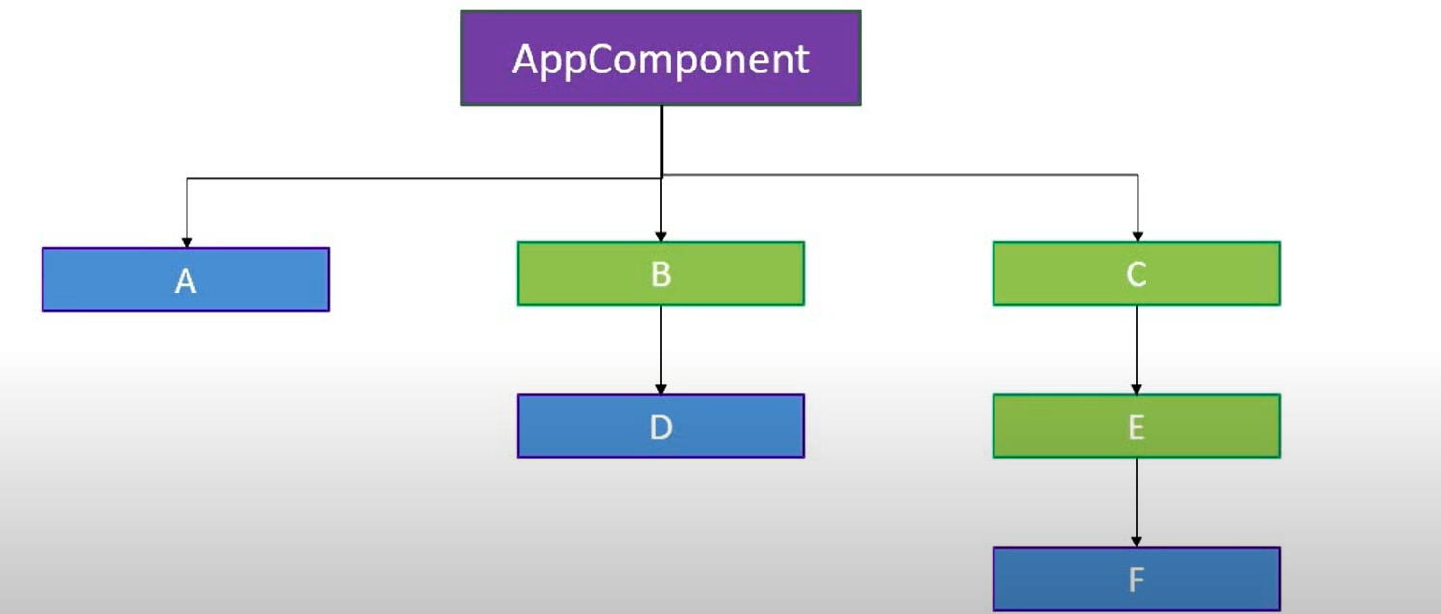
useContext overview:
userContext is a feature that allows you to pass data through the component tree without having to pass props down manually at every level. It provides a way to share information between components that are not directly connected by the parent-child relationship.
userContext is often used to manage global state or theme settings in a React application. It can be especially useful when you have many components that need access to the same data, or when you have deeply nested components that would require many layers of props to pass down.

Slide 9
useReducer overview:
useReducer is a hook that is used to do state management.
It is an alternative to the useState hook, which can be useful in certain scenarios where state management is more complex.
useReducer takes two arguments: a reducer function and an initial state value. The reducer function takes two arguments, the current state and an action object that describes how to update the state. It returns the new state after applying the update specified in the action.
The useReducer hook returns an array with two values: the current state and a dispatch function. The dispatch function is used to update the state and triggers a re-render of the component.
Syntax,
useReducer(reducer, initialState)
NewState = reducer(currentState, action)

Slide 10
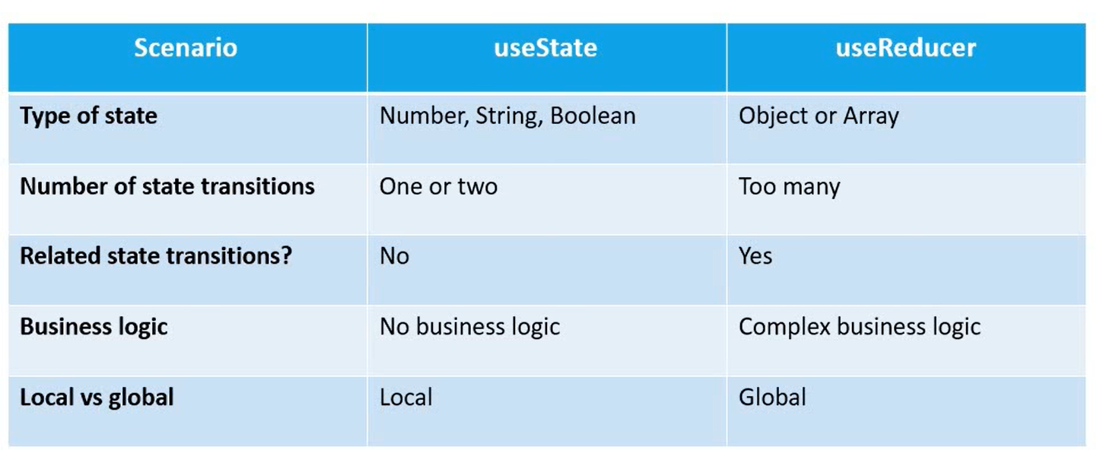
useState vs useReducer:

Slide 11
useMemo overview:
In React, useMemo is a hook that can be used to optimize performance by memoizing the result of a function. It takes two arguments: a function that computes a value and an array of dependencies.
The hook returns a memoized value that will only be recomputed if one of the dependencies has changed.

Slide 12
useCallback overview
The React useCallback Hook returns a memoized callback function. This allows us to isolate resource intensive functions so that they will not automatically run on every render. The useCallback Hook only runs when one of its dependencies update.
Think of memoization as caching a value so that it does not need to be recalculated.

Slide 13
useRef overview
The useRef Hook allows us to persist values between renders. It can be used to store a mutable value that does not cause a re-render when updated.
useRef() only returns one item. It returns an Object called current.

Slide 14
custom Hooks
Hooks are reusable functions. When we have component logic that needs to be used by multiple components, we can extract that logic to a custom hook.
Custom hooks start with "use".

Slide 15
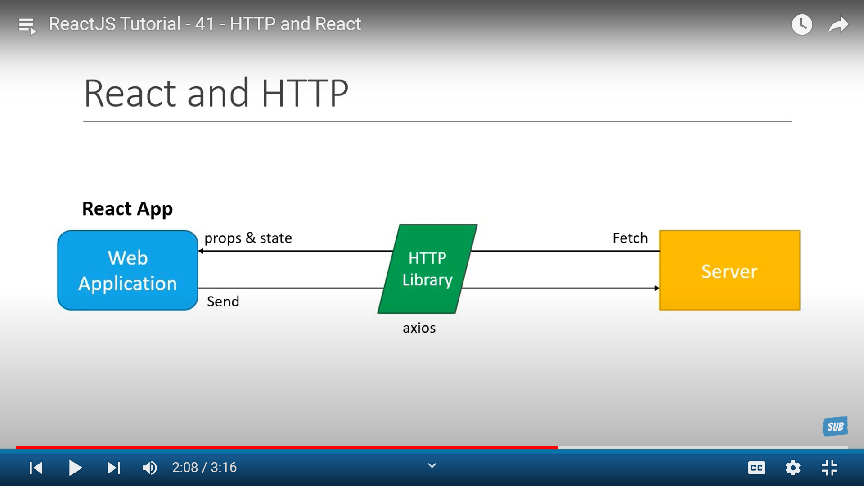
HTTP Request
HTTP request in React is a way for a React app to send a message to a server, asking for some data or to perform an action. The message is sent using the HTTP protocol, which is a set of rules for how messages should be formatted and sent over the internet.
There are different types of HTTP requests, such as GET, POST, PUT, and DELETE.

Slide 16
Axios vs Fetch
There are a few reasons why using Axios might be better than using Fetch in some cases:
Axios has built-in support for handling HTTP errors, while with Fetch you need to check if the response status is between 200 and 299 to determine if the request was successful or not.
Axios can handle request cancellation, which can be useful when you need to cancel a request that is taking too long or is no longer needed.
Axios supports automatic transformation of request and response data, allowing you to easily work with different data formats, such as JSON, XML, or FormData.
Axios supports interceptors, which are functions that allow you to intercept requests or responses before they are sent or received. This can be useful for adding headers, logging, or transforming data.
Axios has a simpler API than Fetch, which can make it easier to use for beginners or for simple use cases.

Slide 17
Axios vs Fetch
fetch('/api/data') .
then(response => { if (!response.ok) {
throw Error(response.statusText);
}
return response.json(); })
.then(data => { console.log(data); })
.catch(error => { console.log(error);
});
axios.get('/api/data') .then(response => { console.log(response.data); }) .catch(error => { console.log(error.response.status); console.log(error.response.data); });

